Slide 1
Part One
The Forms of Software
Documentation
Chapter2: Writing to Teach- Tutorials
Chapter3: Writing to Guide- Procedures
Chapter4: Writing to Support- References

Slide 2
Chapter 4
Writing to Support -Reference-

Slide 3
Introduction
Reference documentation, or support documentation, are the look-up and help parts of a manual. They should be organized in a task-oriented manner, not just alphabetically. When designing reference documentation, it is important to consider the correct form and organization method, as well as the user's needs.
It takes form such as command descriptions, menu overviews, list of definition, function descriptions, and error messages.
This chapter covers how to select the right form of support doc by examining both usual and special forms of reference. Then it will discuss the methods of organizing the reference documentation:
alphabetical, menu by menu, and context sensitive.

Slide 4
Elements of a Reference Structure:
- Function Entry, tells what the function does.
- Declaration , shows how to use the function.
- Remarks, help the user know when to apply the function.
- Edge Bleed, helps the user find the reference entry alphabetically.
- See Also, helps the user see interrelationship among entries.
- Examples, apply the entry to workplace uses.
- Tips, tells how to use the command efficiently.

Slide 5
Guidelines:
1- Choose the Right Form of Reference,
A) Usual forms of reference, quick reference, along with the procedures in a user’s guide.
B) Special forms or reference:
- Appendices, most people see appendix in book the same way they see an appendix in their body: as useless structure. But in fact, the appendix in a software manual often contains some of the most valuable info relating to the use of the program, it gives document writer a place to put all the high detail, technical info, that technical person would want and use in the workplace.

Slide 6
It contains info that relevant and useful, but not essential to all users. If you examine an appendix in software manual you will find:
- Error messages.
- Filenames and extensions.
- Troubleshooting tips.
- Matrixes of compatibility with other programs.
- ASCII charts showing word processor key-combination.
- Printer driver charts showing capabilities with various printer brands.

Slide 7
- Readme Files, are text documents containing important initial information, including installation details or tips, information updated or added after the manual was created, new features in an updated program, revision histories, errors, file descriptions, content of directories, and compatibility requirements.
- Innovative Forms: are documentation that are presented in special formats, such as foldouts, posters, and flip-cards. The advantages of special formats like flip-cards are that they improve readability, contain a lot of information, make information more accessible, and use elements like color to help locate information.
- Keyboard Templates and Short Forms (job aids), it consist of very brief reminder that attach to key-board. Usually limited to defining keys, they can stick to the keyboard or overlap the keys.

Slide 8
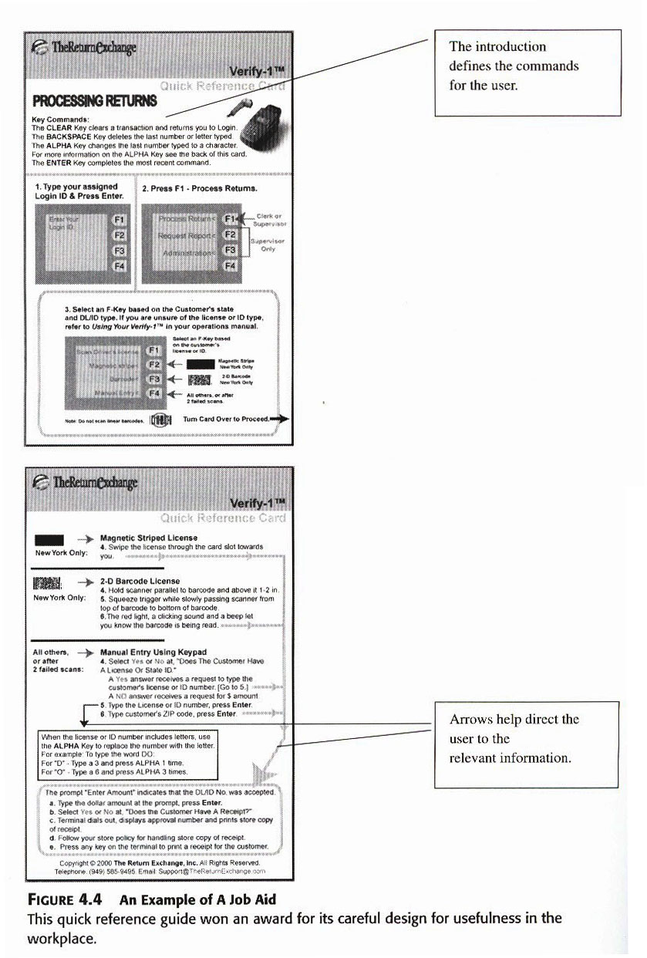

Slide 9
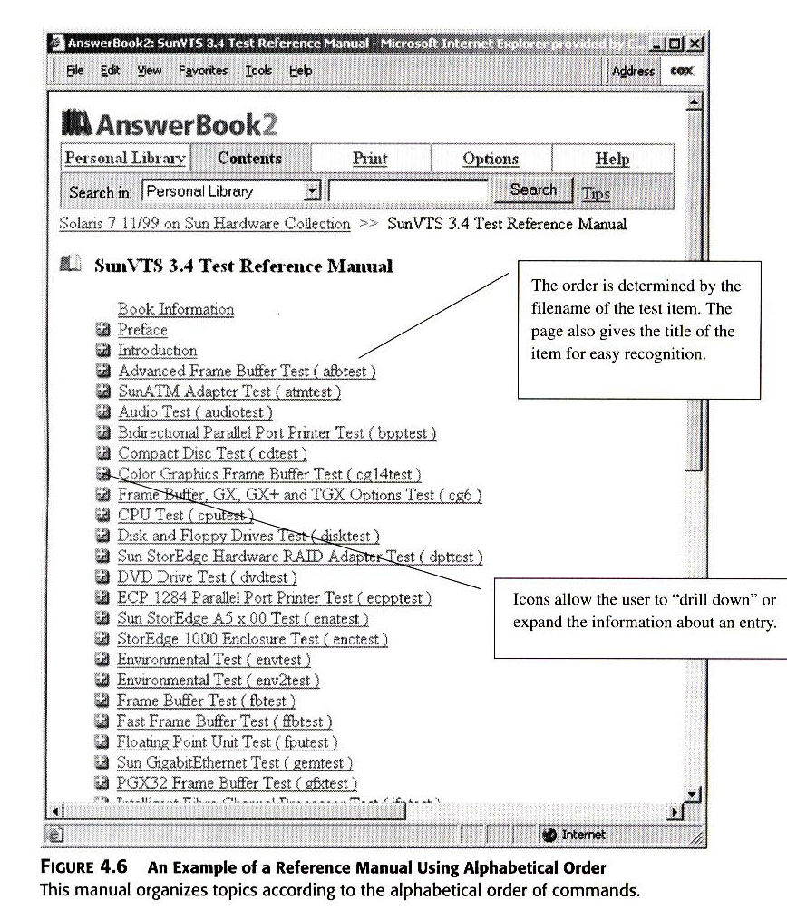

Slide 10
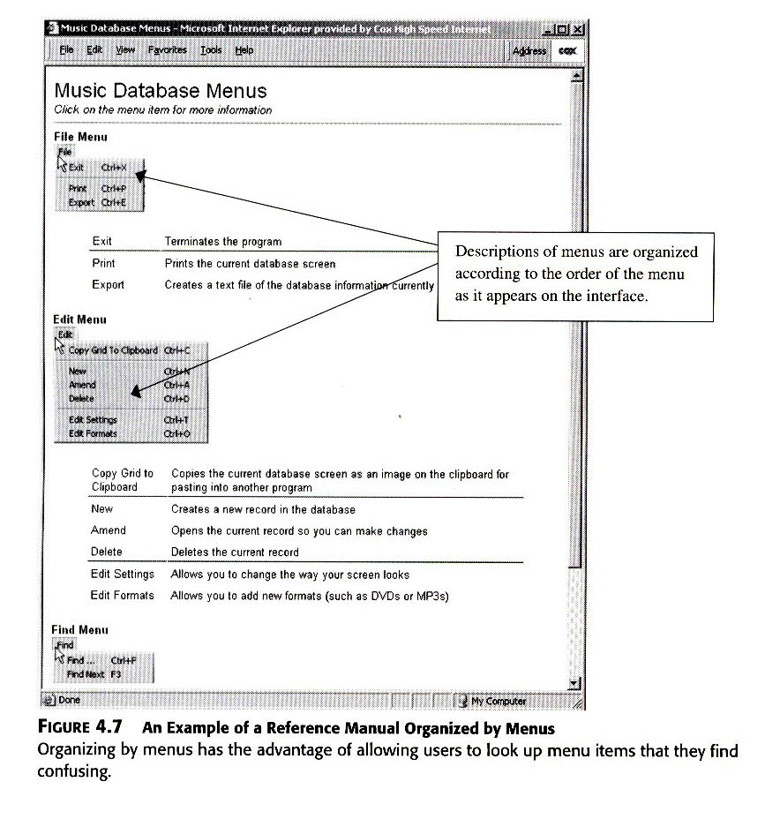

Slide 11
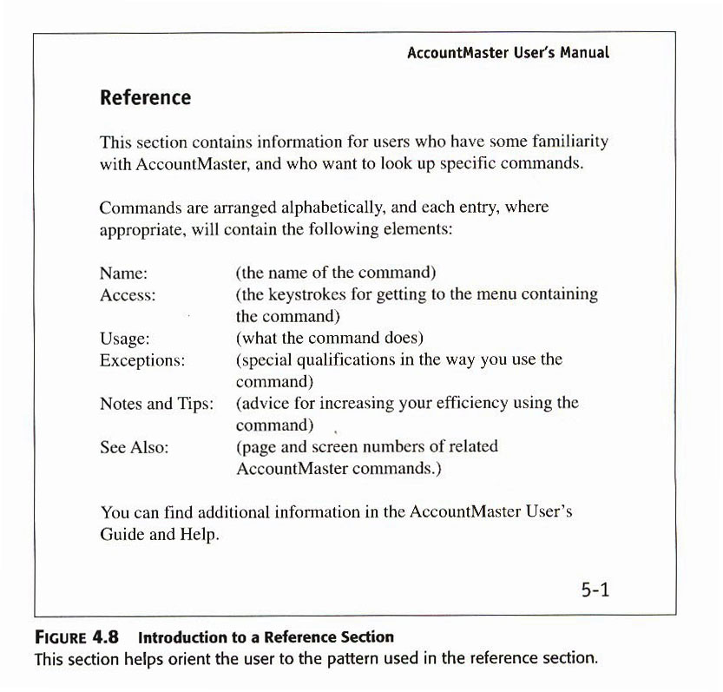

Slide 12
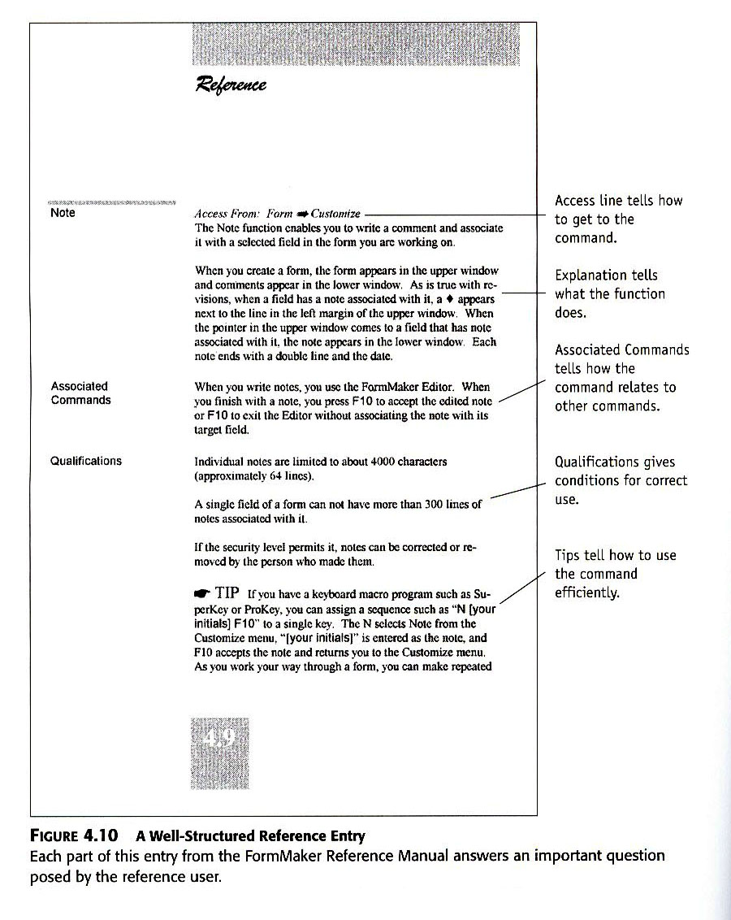

Slide 13
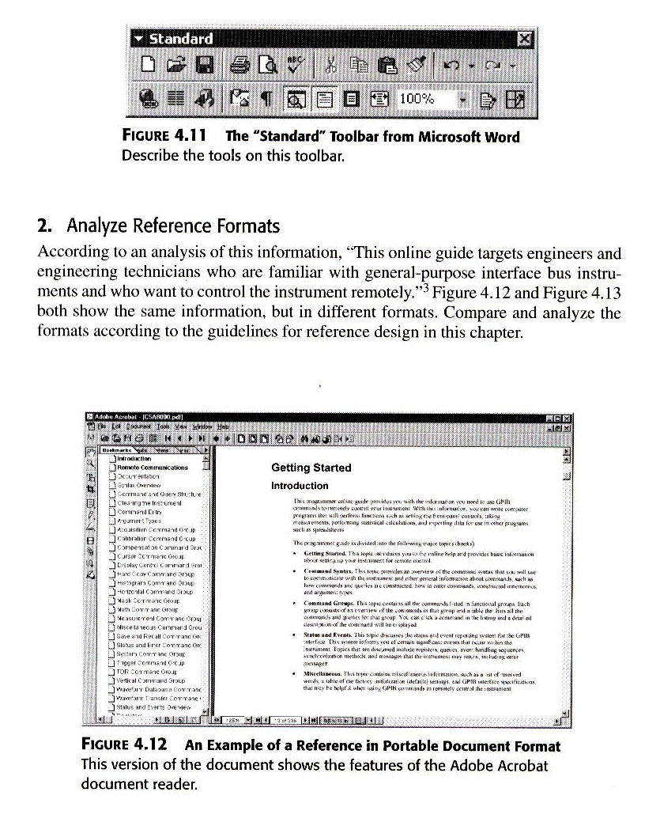

Slide 14
2- Decide What to Include: a- Commands, Commands are the instructions used to work with a program. These include meanings of special function groups, explanations of set commands, definitions of format commands, instructions for using utilities, explanations of toolbars, and definitions of macros. b- Interface Elements, It refers to the part of screen or command line that the user sees and has to read and manipulate in order to put the program to work.
Information about interface elements would include the following: explanations of menus, definitions of keys, labels of screen regions, and explanations of rulers. c- Definition of Terms (glossary), Glossary defines terms used in the manual. Glossaries may defines terms that relate to the software itself or to the subject addressed by the software. concept that relate to the software such as shell, masks and terms relating to the subject matter such as general ledger.

Slide 15
What to Include in A Single Reference Entry?
When developing reference documentation, writers should also consider the content to include in each reference entry.
They may include:
- Conceptual Information explains the term and its function.
- Structural Information explains how the term relates to other terms.
- Technical Information describes the programming information related to the command. The content of each reference entry should be based upon the user's needs.

Slide 16
3- Establish a Pattern, Whatever the content of reference entries, the same pattern should be used for each entry. This helps the user to become familiar with the format. Topics included in patterns of reference entries include definitions, explanations, examples, step-by-step directions, and warnings.
- Definition, tell what the command or function does.
- Explanation, tell how to apply the command or function.
- Example, give an example of the command or function in use.
- Step-by-Step, present abbreviated steps for using the command or function.
- Warning/Cautions, let the user know what problems might a rise.

Slide 17
4- Organize the Reference Section:
- Alphabetical Organization, with functions starting with append command and ending with xcopy. In the case of topics areas, or command sets, you may put them in simple-to-complex order or you might choose to start with the more abstract one, progress to greater and greater level of concrete.
Drawback for alphabetical order it does little to support the task orientation of your manual.

Slide 18
- Menu-by-Menu, you set up your reference section by menu, according to how the user sees them in the program.
Start with main menu then secondary menu.
Present each menu, and then, in the subsequent pages, describe each of the commands in the order they appear on the menu.
The strong advantage of this is its reinforcement of the task orientation of your work.

Slide 19
- Context-Sensitive, you can organize your help section according to the context within which the user ask for help.
This way, your help does not depend on the user knowing the alphabet of commands or the menu where a command resides.
The organization of the work really, does not make that much difference with context sensitive reference, because the user only sees one or two screens at a time.

Slide 20
5- Show How to Use the Reference Info:
In many cases, your document required no instruction.
Maps of menus or summary of commands represent a self- explanatory reference page. However, you should tell the user - usually- in the introduction, the pattern you intend to follow, so he or she establish it in his/her mind, set up the right expectation, and it will serve as a reminder of how you organize each entry.
Such an introduction should explain:
1- Who should use the info, which type of users.
2- How you organize the info, alphabetical or menu bye menu.
3- Element of each entry, list element of each entry.
4- Relation to other section of the documentation, cross reference to other parts of the document.

Slide 21
The Psychology of the Reference User: -
- Reference users do not like to waste time looking things up in help functions or manuals.
- They also dislike having to leave a screen to search for their information. Well-designed documents will cater to the values of efficiency and immediate usability for these users.
As a writer, be sure to establish a pattern and follow it. A good rule to follow: generally, the more structure there is in the information, the more usable the entries are within the document.

Slide 22
The Psychology of a Reference Entry: As the writer, look at the idea behind the repeated categories, column heads, or other user-oriented reference elements. These work for the user because each one answers a question the user might have about a function or command. Keep in mind that the elements of a reference entry respond to the needs of the reference user. Each entry should have the following: Access information, Function definition,
Associated commands, Qualifications/special cases, and Tips.
These elements introduce, orient, inform, and direct the user in the research for a solution.
They work because -each one- answers a question a user may have about a function or command. To see clearly how such an entry works, think of each of the items as answering some need or question of the reference user -as follows:

Slide 23
- How do I get to the function? The experience user need to know how to find a function more than any other info, to get them going. (access information)
-What does the function do? The experienced user very brief explanation of what the function does. (function definition)
-What other commands do I need to know about? The user wants to know how to use the command along with other commands, as well as how to get out of trouble. (associated commands)
- When can I use the function? User needs to know if there is a special condition exist when using a command, such disk drive compatibility or file size limits. (qualifications or special cases)
-How do I use the function well? The experienced user wants to make the most out of the system and needs to know any short cuts or efficiency measures that apply. (Tips)

